Slide 1
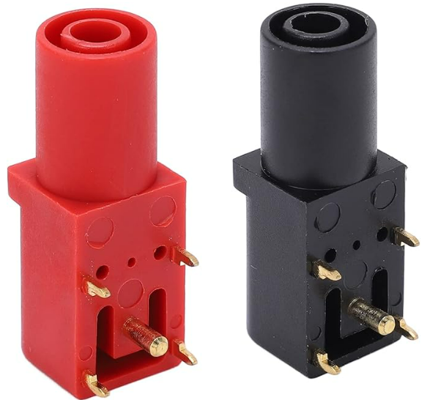
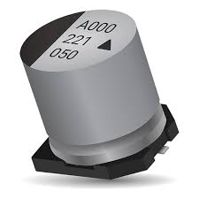
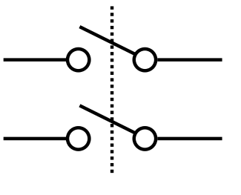
MAIN PWR
RELAY
±20V PWR
MONITOR
INRUSH
LIMITER
BULK STORAGE
-20V INPUT
- LAB SUPPLY 1
-20V NOMINAL
-20V INRUSH CURRENT LIMITER
-20V SWITCHED SUPPLY RAIL
+20V INPUT
+ LAB SUPPLY 2
+20V NOMINAL
+20V INRUSH CURRENT LIMITER
+20V SWITCHED SUPPLY RAIL
MAIN SUPPLY RAIL ENABLE
5V REGULATOR
800mA
5V SYSTEM PWR

Slide 2
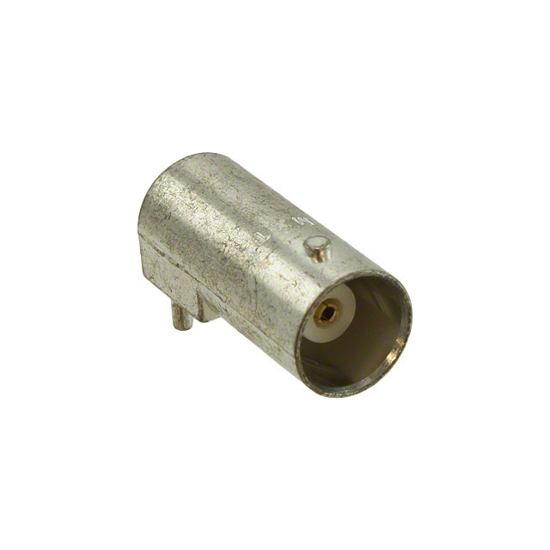
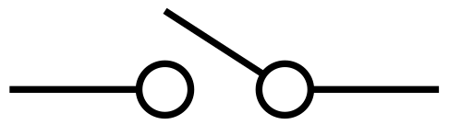
INPUT Z
SWITCHED
50Ω / 1MΩ
Av = 1
DIGITAL
VOLTAGE
DIVIDER
Av = 1
Current
Boost
CURRENT
SENSE
OUTPUT
DISCONNECT
CH1 IN
CH1 OUT
I2C
UI INTERFACE MODULE
STM32F746G-DISCO
ADC
5V SYSTEM PWR
ADC
I2C
INPUT Z
SWITCHED
50Ω / 1MΩ
Av = 1
DIGITAL
VOLTAGE
DIVIDER
Av = 1
Current
Boost
CURRENT
SENSE
OUTPUT
DISCONNECT
CH2 IN
CH2 OUT

